Slide 1
Android
Sec:5&6
Eng:Rasha Sleem

Slide 2
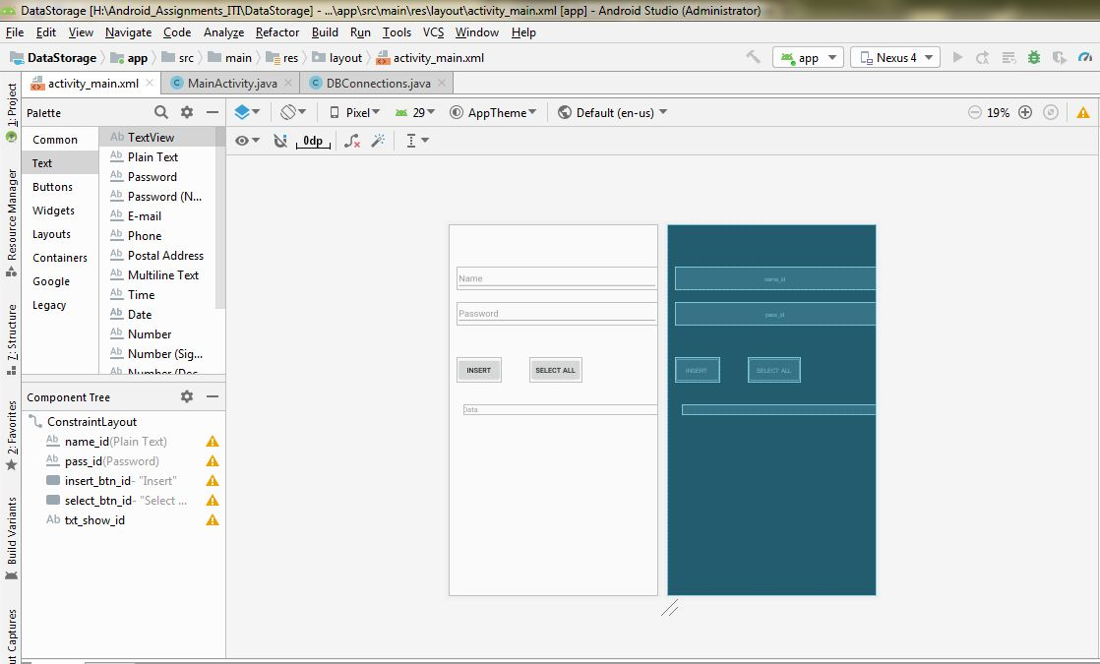
activity_main.xml

Slide 3
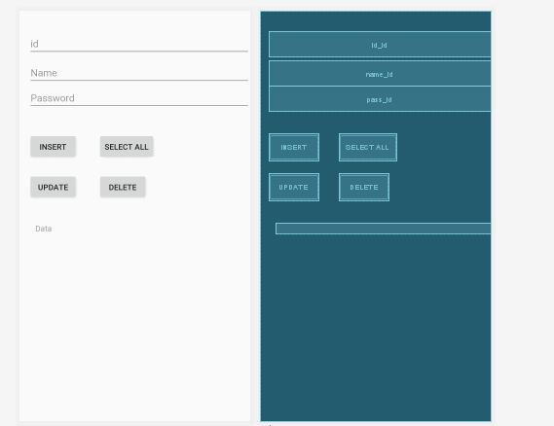

Slide 4
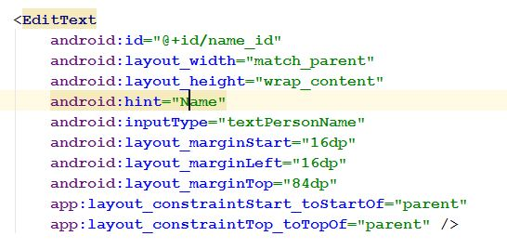
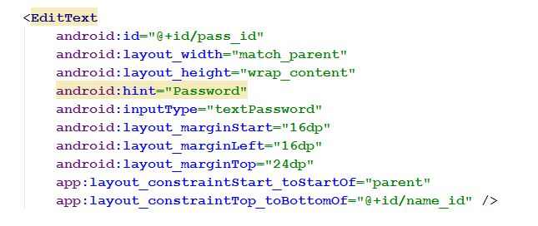

Slide 5
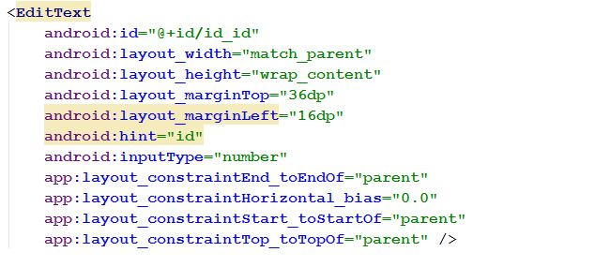

Slide 6
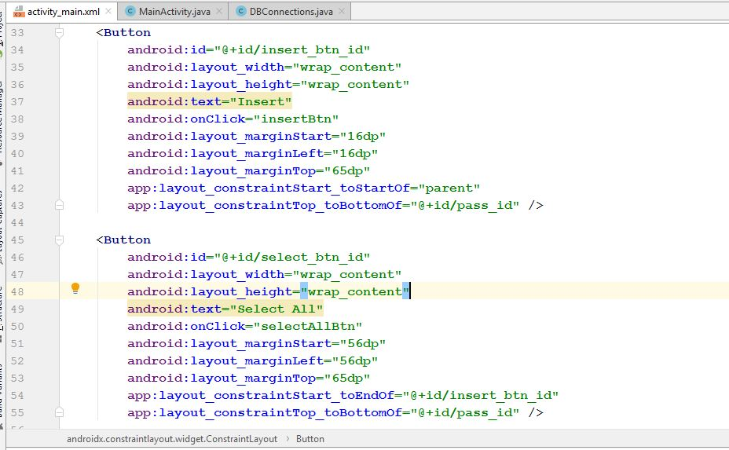

Slide 7
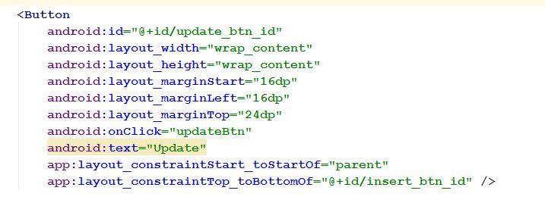
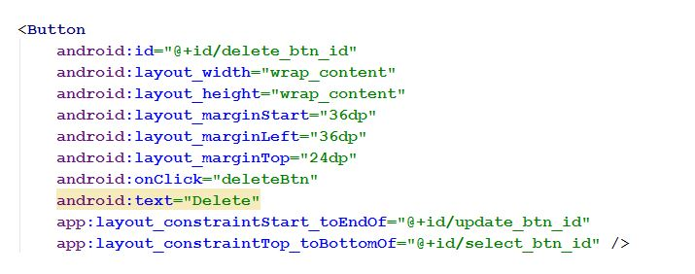

Slide 8
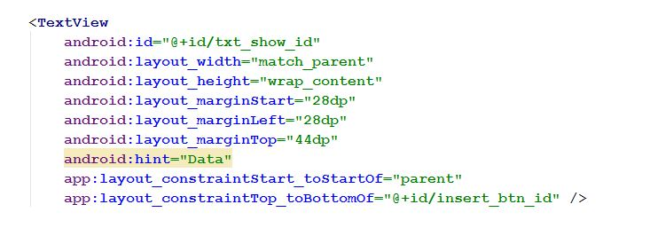

Slide 9
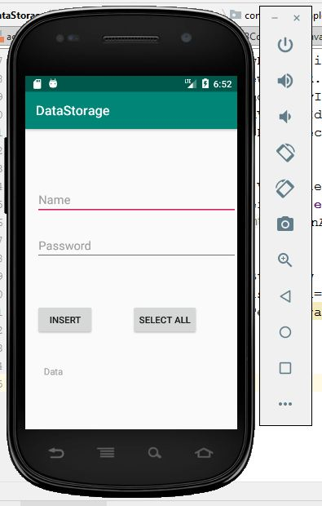

Slide 10
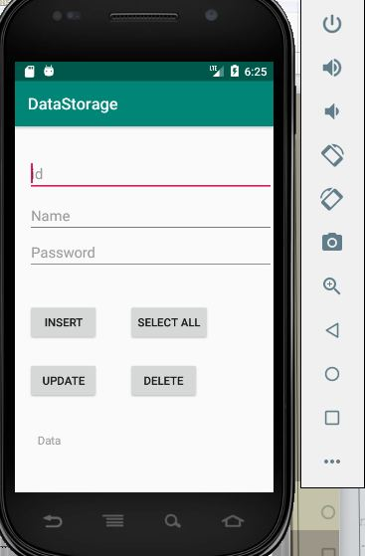

Slide 11
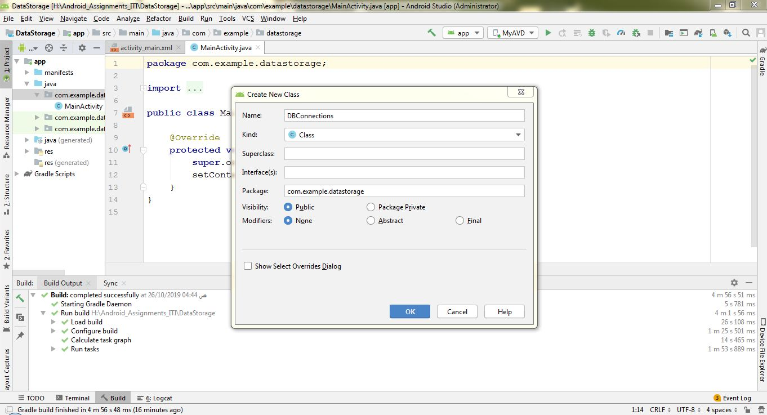
App→java→com.example…(package name)→right click→new class

Slide 12
DBConnections.java
public class DBConnections extends SQLiteOpenHelper {
public static final String DBName="myDataBase";
public static final int version=1;
public DBConnections(Context context){ super(context,DBName,null,version); }

Slide 13
@Override
public void onCreate(SQLiteDatabase db) {
db.execSQL("create table IF NOT EXISTS myTable (id
INTEGER primary key,name TEXT,pass TEXT)"); }
@Override
public void onUpgrade(SQLiteDatabase db, int oldVersion, int newversion) {
db.execSQL("drop table if EXISTS myTable "); onCreate(db); }

Slide 14
public void insertToDB(String name,String pass){
SQLiteDatabase db=this.getWritableDatabase();
ContentValues contentValues=new ContentValues();
contentValues.put("name",name);
contentValues.put("pass",pass);
db.insert("myTable",null,contentValues); }
public ArrayList getData(){
ArrayList dataArray=new ArrayList();
SQLiteDatabase db=this.getReadableDatabase();
Cursor cursor=db.rawQuery("select * from myTable",null);
cursor.moveToFirst();
while(cursor.moveToNext()){
dataArray.add(cursor.getString(0)+cursor.getString(1)+cursor.getString(2)); } return dataArray; }}

Slide 15
public void DeleteRaw(String id){ SQLiteDatabase db=this.getWritableDatabase(); db.execSQL("delete from myTable where id="+id);
// db.delete("myTable","id=?",new String[]{Integer.toString(id)}); }
public void updateRaw(String new_name,String id){ SQLiteDatabase db=this.getWritableDatabase(); db.execSQL("update myTable set name='"+new_name+"'where id="+id);
/* ContentValues c_value=new ContentValues(); c_value.put("name",new_name); db.update("myTable",c_value,"id=?",new String[]{id}); */ }

Slide 16
MainActivity.java
public class MainActivity extends AppCompatActivity {
EditText edit_name,edit_pass,edit_id;
Button btn_insert,btn_select_all;
TextView txt_show_data;
DBConnections dbConnections;
@Override
protected void onCreate(Bundle savedInstanceState) {
super.onCreate(savedInstanceState); setContentView(R.layout.activity_main);
edit_name=findViewById(R.id.name_id); edit_pass=findViewById(R.id.pass_id);
edit_id=findViewById(R.id.id_id);
btn_insert=findViewById(R.id.insert_btn_id); btn_select_all=findViewById(R.id.select_btn_id); txt_show_data=findViewById(R.id.txt_show_id);
dbConnections=new DBConnections(this); }

Slide 17
public void insertBtn(View view) {
dbConnections.insertToDB(edit_name.getText().toString(),
edit_pass.getText().toString());
Toast.makeText(MainActivity.this,"ok",Toast.LENGTH_SHORT).show(); }
public void selectAllBtn(View view) {
ArrayList array_List_data=dbConnections.getData();
txt_show_data.setText(array_List_data.toString()+"\n"); } }

Slide 18
public void updateBtn(View view) { dbConnections.updateRaw(edit_name.getText().toString(),edit_id.getText().toString());
ArrayList array_List_data=dbConnections.getData(); txt_show_data.setText(array_List_data.toString()+"\n"); }
public void deleteBtn(View view) { dbConnections.DeleteRaw(edit_id.getText().toString());
ArrayList array_List_data=dbConnections.getData(); txt_show_data.setText(array_List_data.toString()+"\n"); }

Slide 19
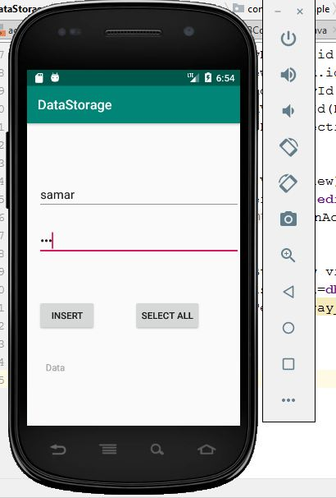
Insert

Slide 20
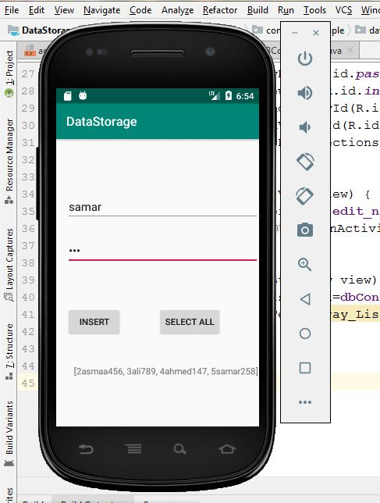
Select

Slide 21
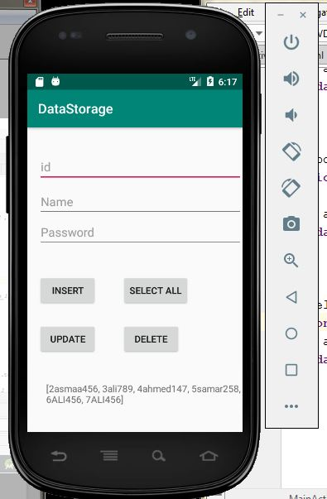

Slide 22
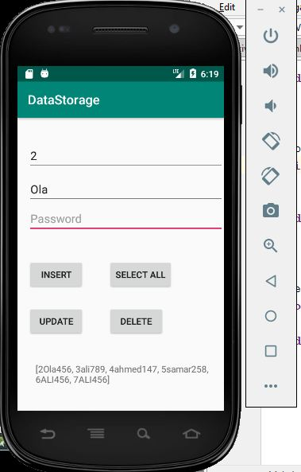
update

Slide 23
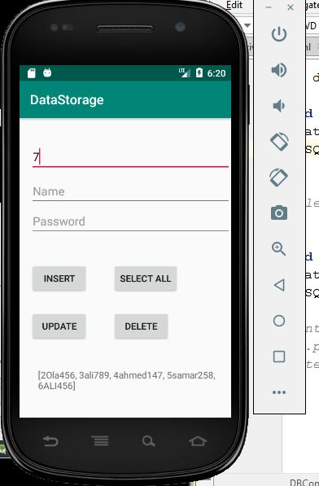
Delete

